Slide 1
Predicting Air Quality and Pollutant Levels in the US
By Varsha Suresh,
Lasya Bheemendra Nalini, and Auni Bagchi
Group 9

Slide 2
Topic Overview
Introduction
Objective
Dataset
Data Preprocessing
Association Analysis
Regression Analysis
Visualization
Conclusion
Recommendation

Slide 3
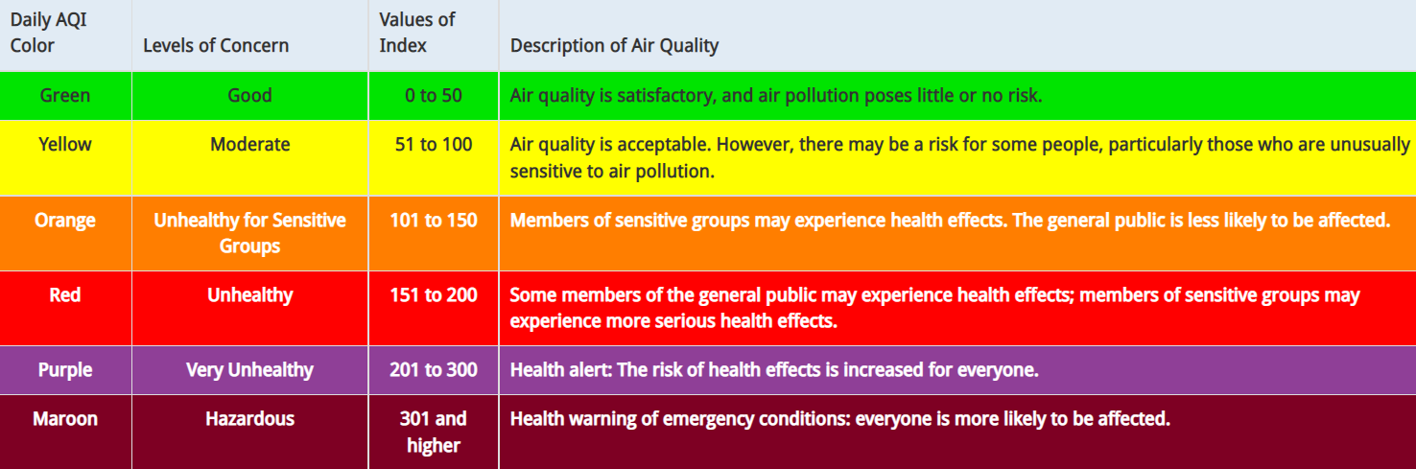
Introduction
5 main pollutants: PM 2.5 (Particulate Matter), Ozone, CO (Carbon Monoxide), SO2 (Sulfur Dioxide), and NO2 (Nitrogen Dioxide)
Each pollutant maps to the Air Quality Index, or AQI, which has the following indexes:

Slide 4
Objective
Use Daily Summary Data of 5 main pollutants from past years in order to accurately predict future AQI values
Understand relationship between AQI and population, AQI and Location Setting, AQI and Land Usage

Slide 5
Dataset
The air quality, land use, and location setting data from the EPA is collated for a period of 21 years in our analysis, from 2000 to 2020
The population data is sourced from the US Census Bureau
Our training data consisted of daily summary data for a period of 18 years, from 2000 to 2017
~1 million+ records for each of the 5 pollutants
The test data used was for a period of 3 years, from 2018 to 2020
~200k+ records for each pollutant

Slide 6
Data Preprocessing
For each of the Pollutant Daily Summary Data Files:
Extracting day, month, and year of measurement
Keeping only appropriate Sample Duration for each pollutant (ie: 1 hr for NO2, 8 hr run avg for Ozone)
Using a label encoder to convert categorical values to numeric data where needed for use in prediction models
Discarding non-salient features
Dropping duplicate records or records with NaN values

Slide 7
Association Analysis
Performed Chi-square test and found Air Quality is dependent on Location Type and Land Usage.
Location Type refers to Rural, Urban and Suburban lands
Land Usage refers to Industrial, Residential, etc.
Using Pearson method found positive correlation with small strength between Air Quality and County Population.

Slide 8
Regression Analysis
Regression Algorithms considered
Linear Regression
Bayesian Ridge Regression
Random Forest Regression
Gradient Boosting Regression
Gradient Boosting Regressor predicted with high accuracy for most pollutants considered.

Slide 9
Regression Analysis
Pollutant | Model | Accuracy
PM2.5 | GradientBoostingRegressor (n_estimators = 40) | 99.52%
Ozone | GradientBoostingRegressor (n_estimators = 30) | 99.28%
CO | GradientBoostingRegressor (n_estimators = 30) | 99.40%
SO2 | GradientBoostingRegressor (n_estimators = 40) | 98.20%
NO2 | LinearRegression | 99.76%

Slide 10
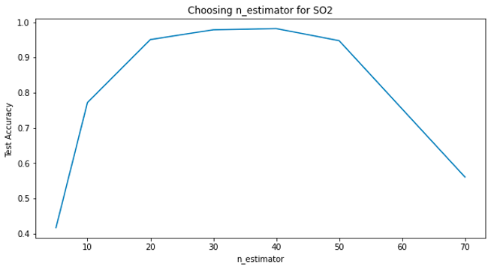
Regression Analysis
We chose n_estimator based on accuracy achieved for each pollutant.
The best parameters provided by GridSearchCV did not yield best accuracy.

Slide 11
Result Analysis
Combining pollutants’ predicted AQI and taking max among them for the same date
Group by site number within county and get max AQI
Merge with site information
Merge with population information

Slide 12
Visualization
Display county data for site which has max AQI among all sites within county, according to EPA.
Categorize AQI to fall within good/moderate/unhealthy ranges
Display the number of good/moderate/unhealthy days of AQI for a county per month
Dashboard: https://public.tableau.com/shared/3K74FSF44?:display_count=n&:origin=viz_share_link

Slide 13
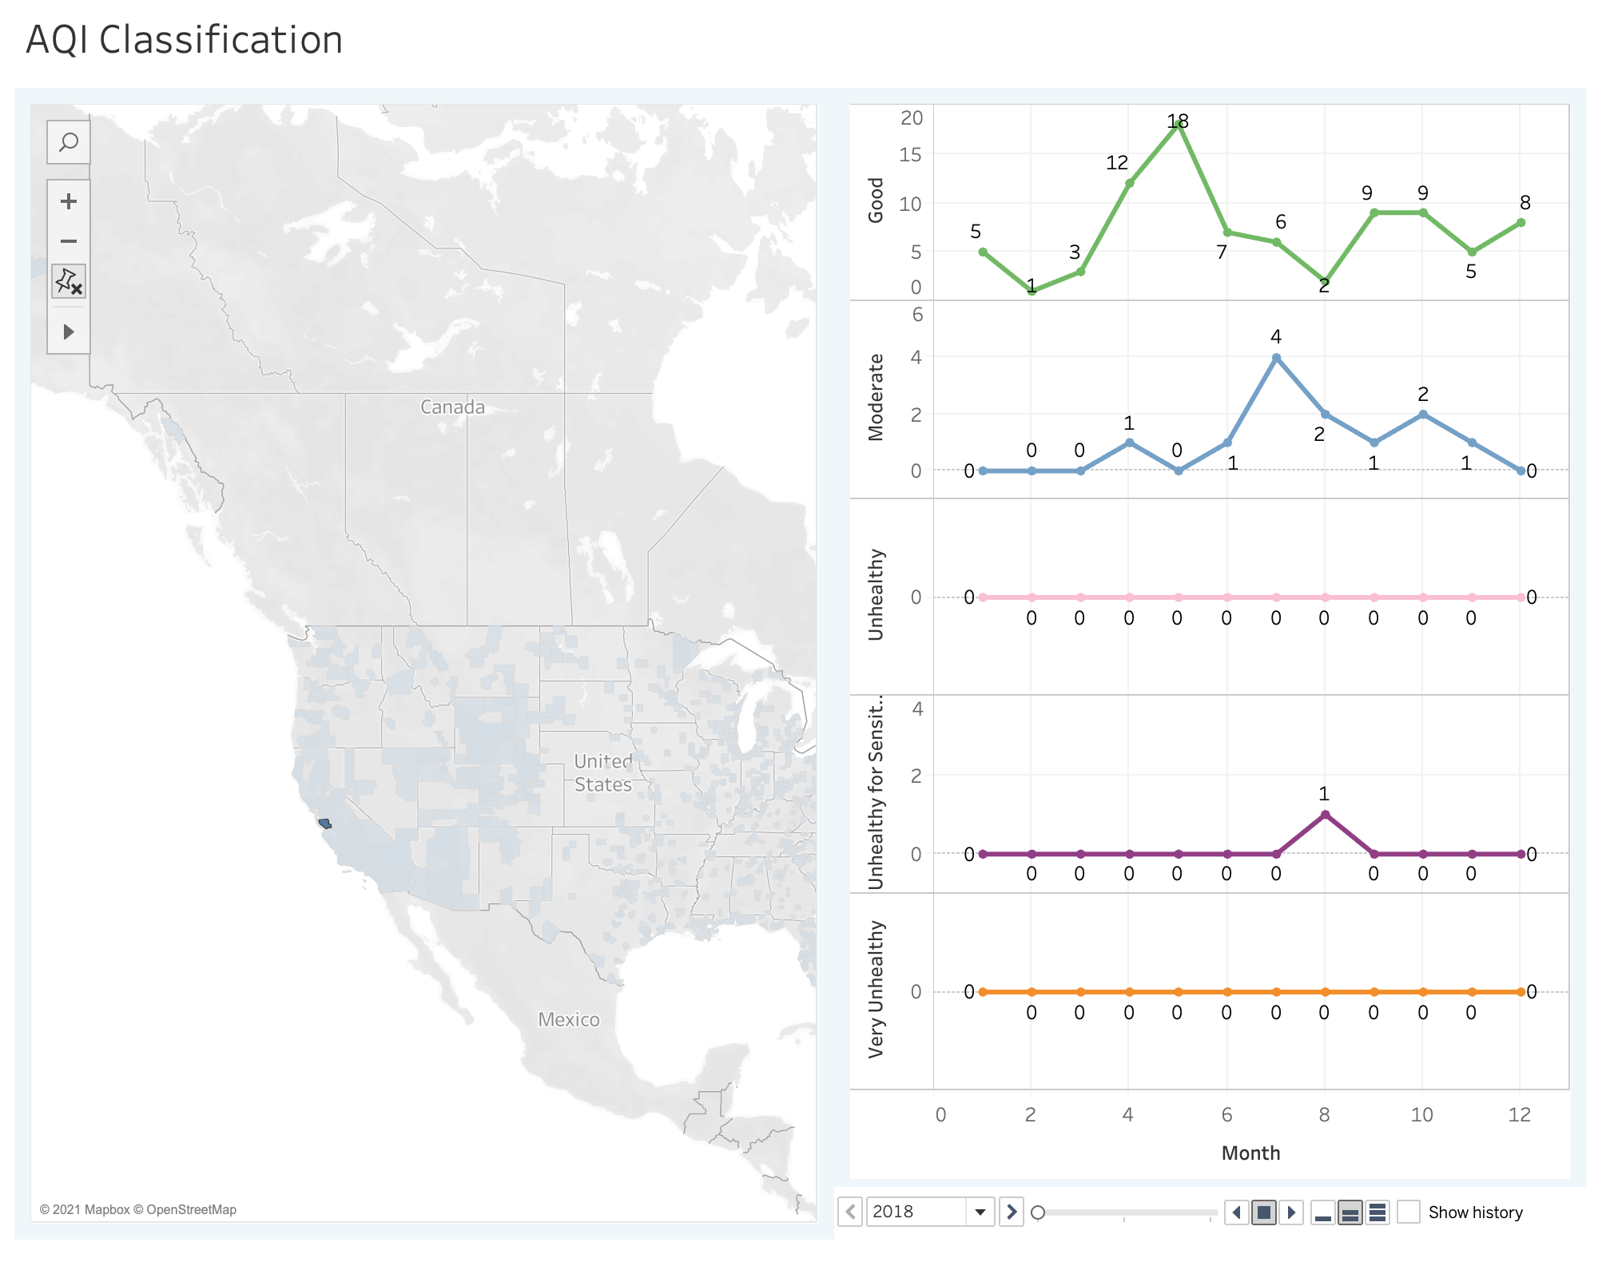
Visualization

Slide 14
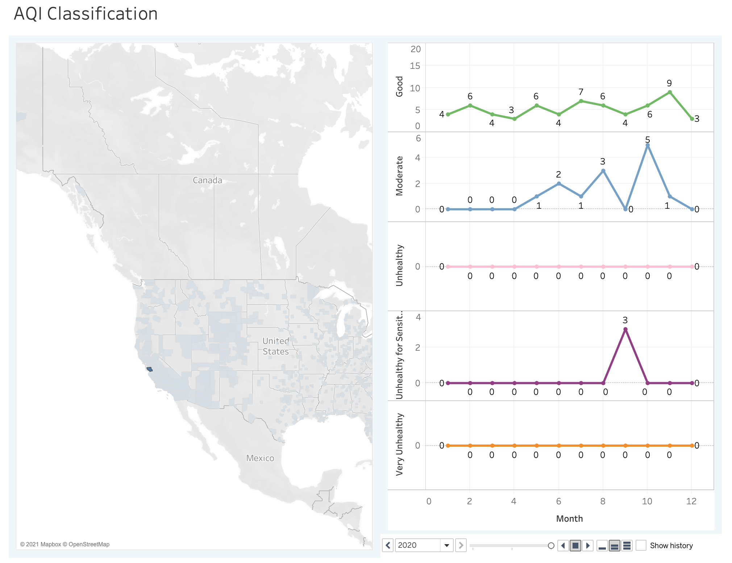

Slide 15
Conclusion
We were able to predict the AQI with a good accuracy
We observed that land use, location setting, and population have a positive relationship with AQI, albeit to a small degree

Slide 16
Recommendation
Study the effect of vehicles per capita on the AQI of a county/state subject to availability of data
Predicted air quality can be used by travel plan recommendation applications to issue warnings

Slide 17
Thank You!

